Slide 1
PREDICTIVE CUSTOMER RENTENTION MODEL USING DEEP LEARNING

Slide 2


SCOPE
To make predictive analysis of Customer Retention using Deep Learning Principles on real-time industrial data.
PACKAGES USED

Slide 3
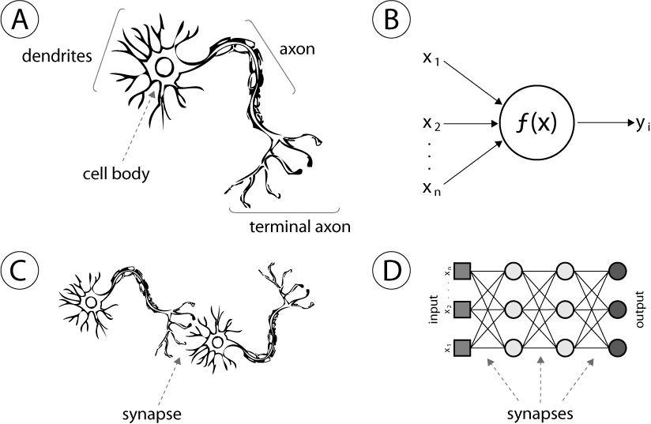
IMPLEMENTATION
Customer Churn Model is implemented using TensorFlow and SciKit Learn
The basic proposed neural network approach to building a churn is followed by building an Artificial Neural Network (ANN)
ARTIFICIAL NEURAL NETWORK
Complex network that comprises a large set of simple nodes known as neural cells
ANN was proposed based on advanced biology research concerning human brain tissue and neural system, and can be used to simulate neural activities of information processing in the human brain

Slide 4
STEPS INVOLVED IN MAKING THE MODEL
DATA COLLECTION
DATA PREPROCESSING
BUILD THE MODEL
REPORT RESULTS
PREDICTION
TRAIN AND TEST THE MODEL

Slide 5
PROCESS
The customer data from 2013 to 2017 was collected, preprocessed and split into training and testing sets
A Peer churn model was designed for the above dataset
Model was designed using Artificial Neural Networks
The training set was used to train the model over 100 epochs
The testing set was then fed into the model to derive the prediction set
The prediction set was then mapped onto the 2018 data to validate the results

Slide 6
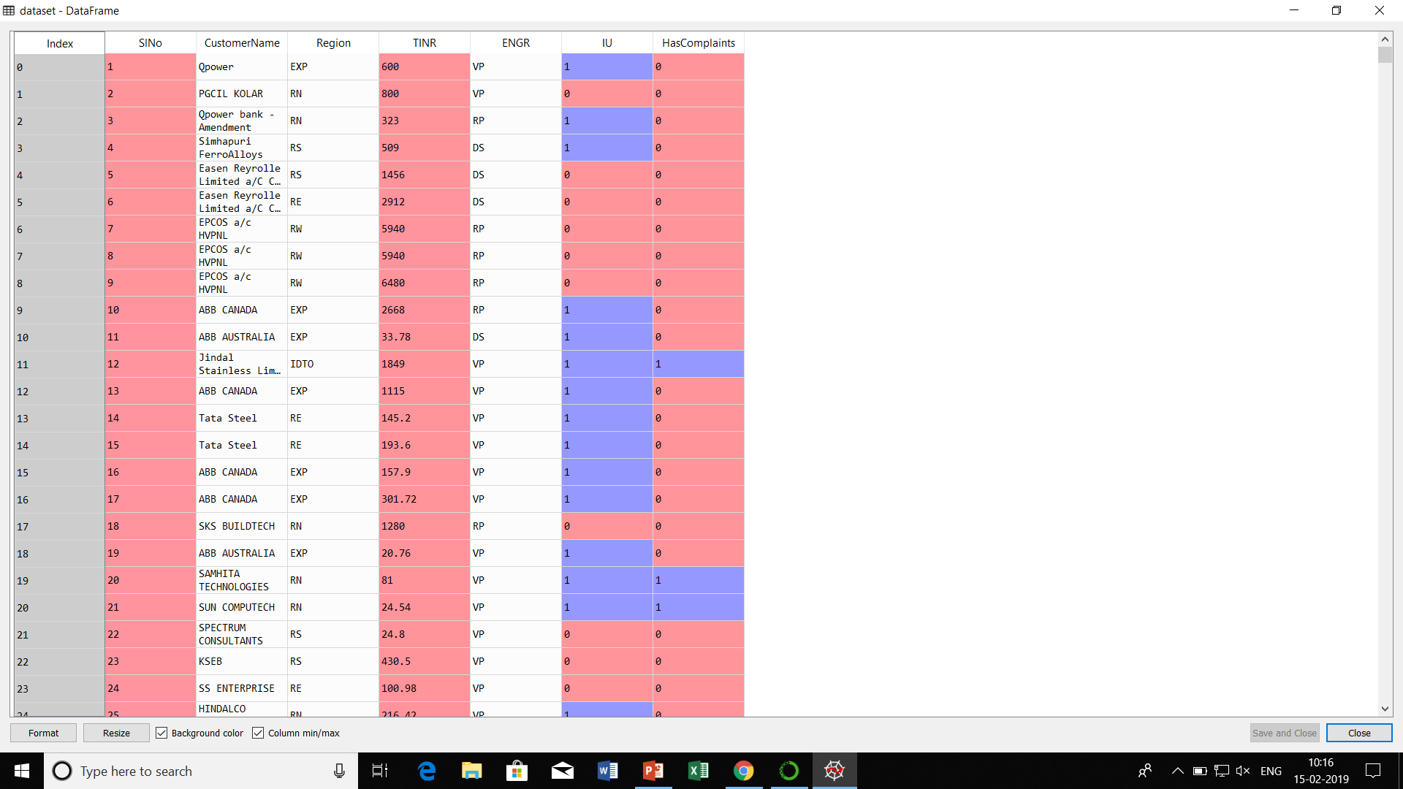
DATASET

Slide 7
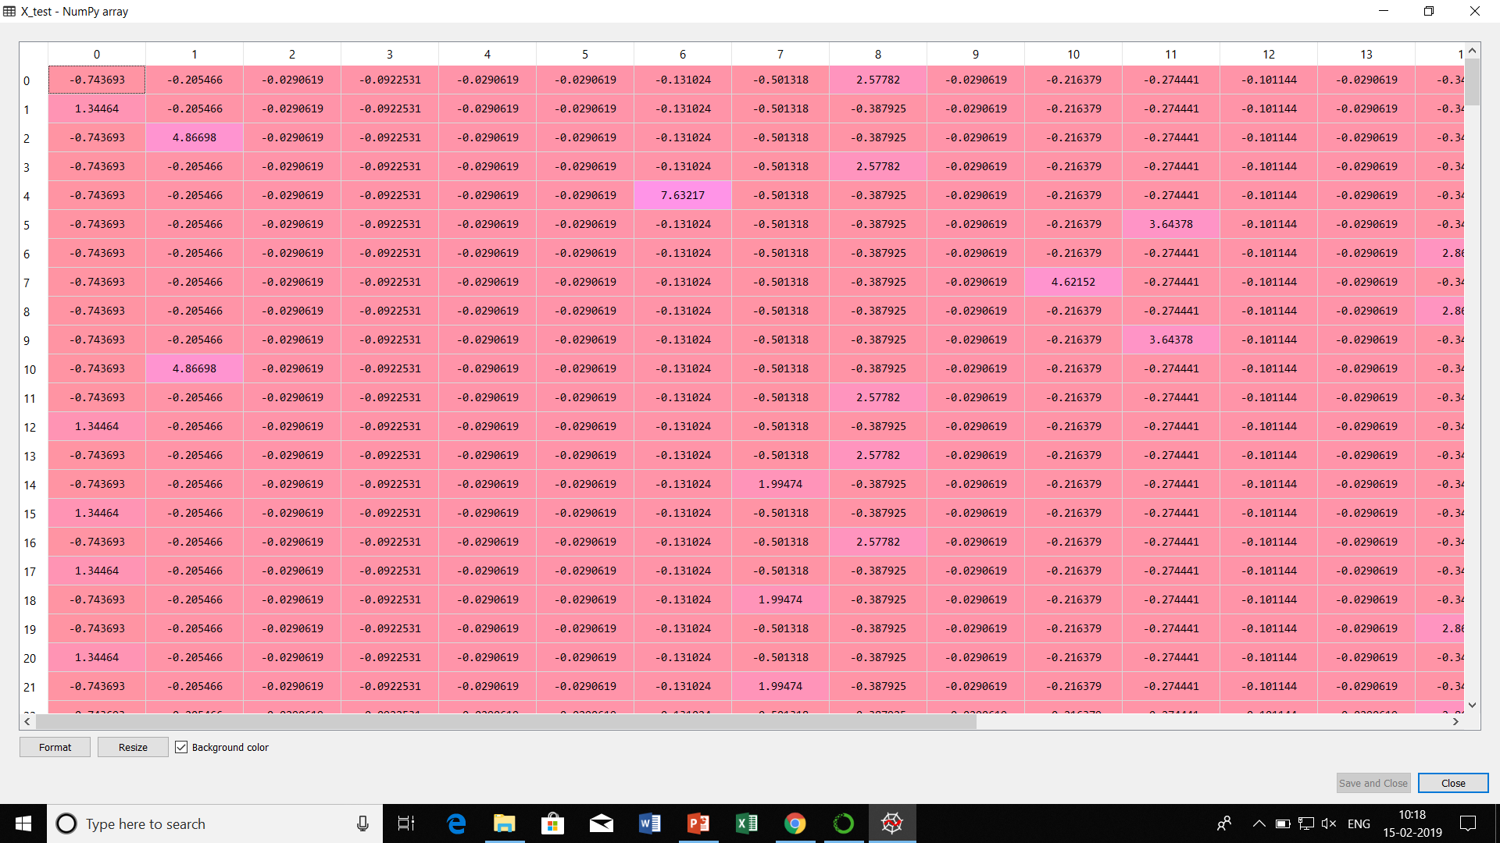
DATASET AFTER CONVERTING INTO MATRIX OF FEATURES

Slide 8
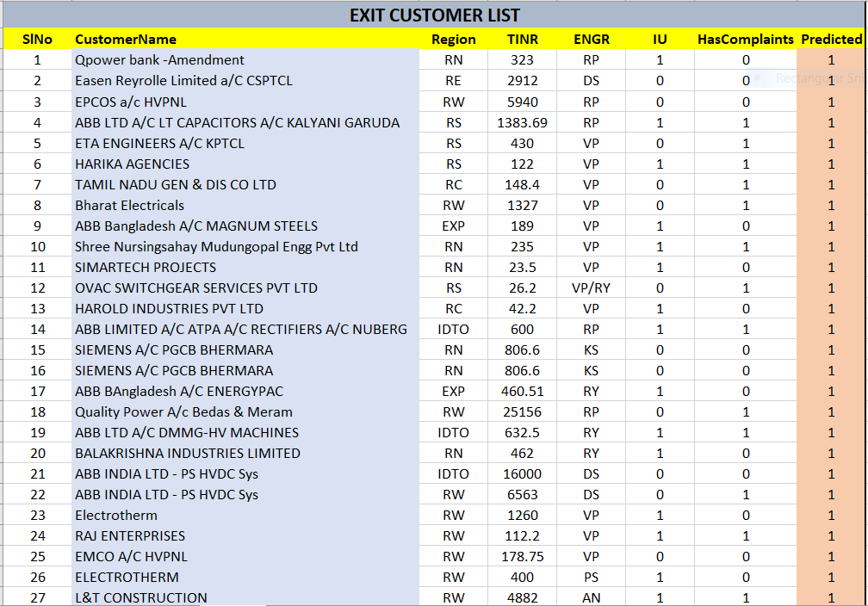
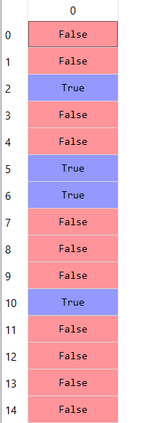
OUTPUTS

Slide 9
THANK YOU FOR YOUR ATTENTION

